Slide 1
USER-CUSTOMIZED RESTAURANT RECOMMENDATION USING NLP ON OUR CUSTOMIZED YELP DATASET
Spring 2020: CSE6240: Web search and Data Mining
Somdut Roy Vitaly Marin Devanshee Shah
slide version 4.1

Slide 2
Motivation/Introduction
Problem Description: You want to get a recommender system to provide a feedback where best to eat (at which restaurant) that you have not been before provided your favorite restaurant only and restaurant user review/ratings. This presents a challenging problem.
Problem Importance: user recommender systems exist; however those have not been applied to our customized restaurant dataset with user ratings and <todo add here more>

Slide 3
Methodology: Baseline Approaches/Algorithms
What are our baseline Approaches ?
Baseline Approach #1: Linear SVM classifier
Baseline Approach #2: Logistic Regression
Description of how each baseline
approach work (baseline 1) : as shown here 🡪
Description of how each baseline
approach work (baseline 2): as shown here 🡪
Yelp Restaurant Review- Rating Dataset
Ratings + Reviews
User Reviews
Restaurant Reviews
Training for Ratings using
Baseline 1: Linear SVM
Baseline 2: Logistic Regression

Slide 4
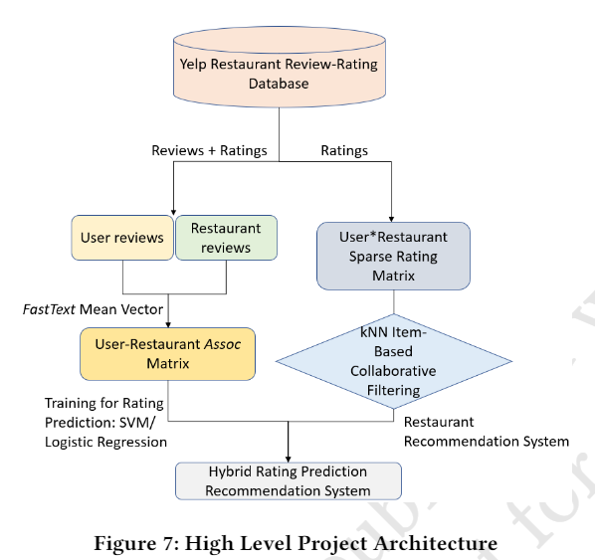
Our Approach/Algorithms Description
Our approach combines user restaurant ratings prediction based on Linear SVM (Baseline 1), Logistic Regression (Baseline 2) and item based collaborative filtering techniques to create a hybrid ratings that can be used to sort the relevant restaurants for a specific user that user given only user’s preference for specific restaurant.
Our model is summarized in the diagram 🡪

Slide 5
Our Approach and Benchmarks #1, 2 using accuracy metric
Yelp Restaurant Review- Rating Dataset
Yelp Restaurant Review- Rating Dataset
Ratings + Reviews
Ratings + Reviews
User Reviews
Restaurant Reviews
User Reviews
Restaurant Reviews
User-Restaurant AssocMatrix
Training for Ratings using
Baseline 1: Linear SVM
Baseline 2: Logistic Regression
Training/Testing for Ratings using Method 1 : Linear SVM and
Method 2: Logistic Regression

Slide 6
Our Approach Combined for a recommender tool with hybrid qualitative ratings (right)
Yelp Restaurant Review- Rating Dataset
Ratings + Reviews
User Reviews
Restaurant Reviews
User-Restaurant AssocMatrix
Training/Testing for Ratings using Method 1 : Linear SVM and
Method 2: Logistic Regression

Slide 7
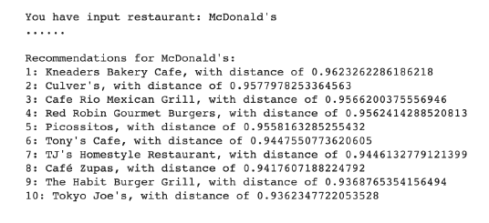
KNN –Item based Collaborative Filtering
Fuzzy method and Cosine similarity distances used to get 10 restaurant recommendations for given query word.
Result distances further computed with user-restaurant assoc matrix to get hybrid rating.
Users
 | 1 | 2 |  | n-2 | n-1 | n
1 | 0 | 3 |  | 4 | 4 | 3
2 | 1 | 2 |  | 4 | 3 | 2
m-2 | 2 | 4 |  | 3 | 2 | 0
m-1 | 2 | 4 |  | 3 | 2 | 0
m | 1 | 2 |  | 4 | 5 | 3
Restaurants
User- Restaurant Sparse Matrix for Collaborative Filtering
Restaurants m-2 and m-1 are having very high cosine similarity based on the ratings to both the restaurants given by users 1, 2, n-2 and n-1.

Slide 8
Our Approach/Algorithms Novelty
The Novelty of our approach is to create the hybrid ratings by combining rating prediction for restaurants and Item based collaborative filtering to restaurant dataset together.
Created the Associative Matrix and used the FastText.
(potentially combine this slide with other slides or so)

Slide 9
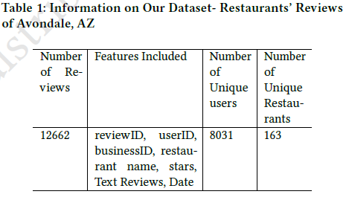
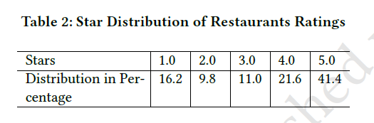
Our Dataset: Filtered Yelp Dataset. Finalized
Description of dataset and its useful features and our dataset was constructed using Yelp dataset using Avondale, AZ city.

Slide 10
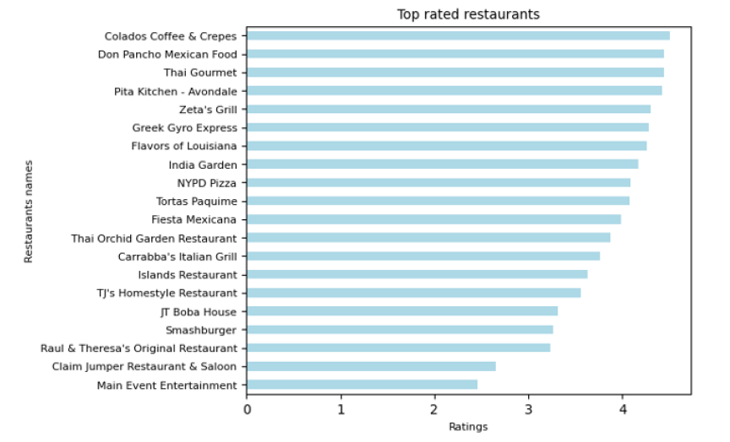
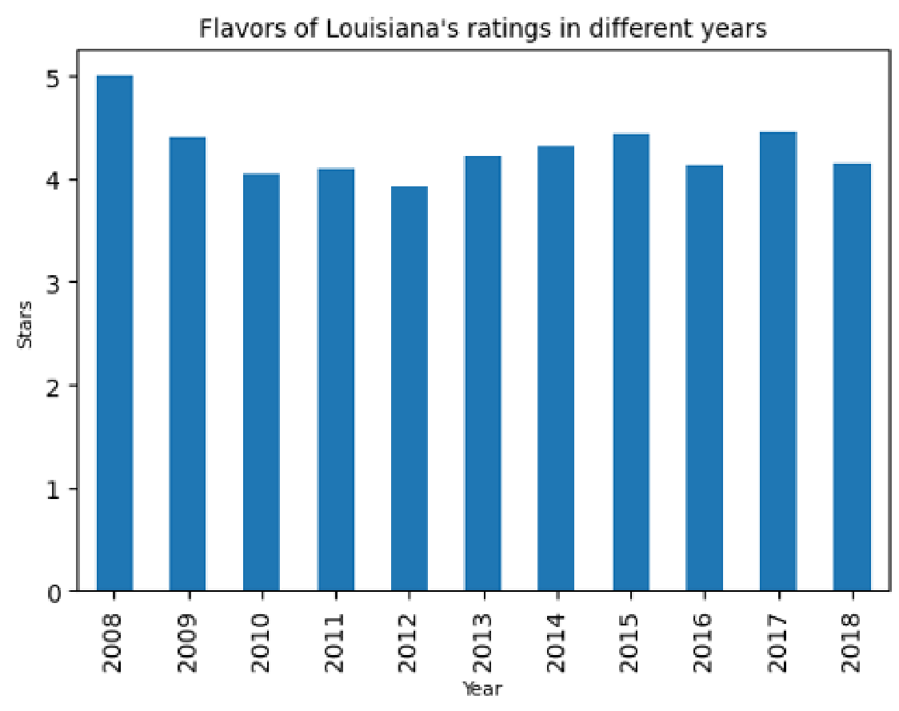
Our Dataset: customized Yelp Dataset. Finalized Cont. Features/Details

Slide 11
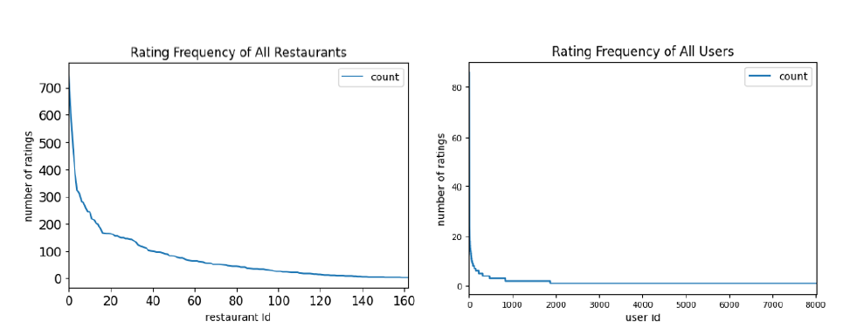
Our Dataset: Rating Frequency of Restaurants’ and User Frequency of all users

Slide 12
Experiments and Evaluations
Description of the experimentation setup .
We used Google collab to run our experiments.
Description of evaluation criteria for the experiment: (accuracy of the predicted ratings )

Slide 13
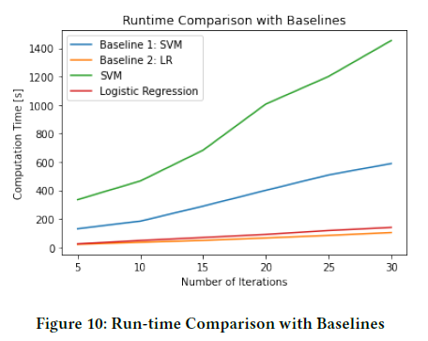
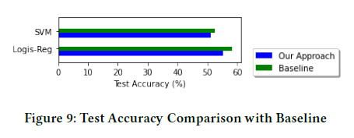
Our Results
<todo add info on results>.

Slide 14
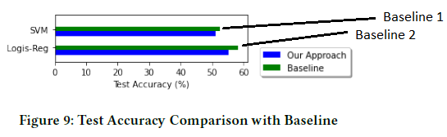
Our Results and Comparison to Baseline Results.
Using Accuracy as the measure of performance
and time in seconds as wall time for each algorithm
Our results are shown here.

Slide 15
Summary of Our results
Method | Accuracy | Time Compcomplexity
Baseline 1 SVM without Matrix (what paper ?) |  | Somdut will provide the numbers on this
Our Approach with Matrix SVM |  | Somdut will provide the numbers on this
Our Approach Logistic Regression with Matrix |  | Somdut will provide the numbers on this
Our Approach Logistic Regression without Matrix |  | Somdut will provide the numbers on this
Baseline 2 Logistic Regression without Matrix |  | Somdut will provide the numbers on this
Our Approach with Matrix SVM
Our Approach Logistic Regression with Matrix

Slide 16
Future Work
We will use the reviews for the item based collaborative filtering in the future work to benchmark it against our other two approaches.

Slide 17
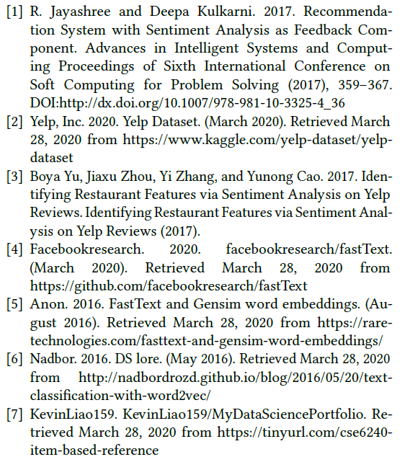
References:

Slide 18
Delete: Notes to self.
Need to create a slide and put it at the beginning of the presentation as a use case to show:
Types of predictions:
Combined system: User A ( no needed rated restaurant G), Given favorite restaurant Z what is next great restaurant X to go to ?( combined system) with right side and left side.
Left side of the diagram: User A ( rated restaurants several restaurants), what is the rating of any restaurant that the user has not been to.
What is really needed ? (did the user really need to rate anything ?)
User A provided what his/her favorite restaurant is.
Does the favorite restaurant Z need any ratings ?
Does the recommended restaurant X need any ratings ?

